Slide 1

Chapter 1 Introduction
Lecturer: Jackie Stewart
Room: X309
E-mail: Jackie.stewart@tus.ie
Computer Networking: A Top-Down Approach 8th edition Jim Kurose, Keith Ross Pearson, 2020

Slide 2

Chapter 1: roadmap
What is the Internet?
What is a protocol?
Network edge: hosts, access network, physical media
Network core: packet/circuit switching, internet structure
Performance: loss, delay, throughput
Security
Protocol layers, service models
History

Slide 3

How do packet delay and loss occur?
packets queue in router buffers, waiting for turn for transmission
queue length grows when arrival rate to link (temporarily) exceeds output link capacity
packet loss occurs when memory to hold queued packets fills up
packet being transmitted (transmission delay)
A
B
packets in buffers (queueing delay)
free (available) buffers: arriving packets
dropped (loss) if no free buffers

Slide 4
Packet delay: four sources
transmission
A
propagation
B
nodal
processing
queueing
d_{nodal} = d_{proc} + d_{queue} + d_{trans} + d_{prop}
d_{proc}: nodal processing
check bit errors
determine output link
typically < microsecs
d_{queue}: queueing delay
time waiting at output link for transmission
depends on congestion level of router

Slide 5
Packet delay: four sources
transmission
A
propagation
B
nodal
processing
queueing
d_{nodal} = d_{proc} + d_{queue} + d_{trans} + d_{prop}
d_{trans}: transmission delay:
L: packet length (bits)
R: link transmission rate (bps)
d_{trans} = L/R
d_{prop}: propagation delay:
d: length of physical link
s: propagation speed (~2x10⁸ m/sec)
d_{prop} = d/s
d_{trans} and d_{prop}
very different

Slide 6



Packet-switching: store-and-forward
L bits
per packet
source
3
2
1
destination
R bps
R bps
packet transmission delay: takes L/R seconds to transmit (push out) L-bit packet into link at R bps
store and forward: entire packet must arrive at router before it can be transmitted on next link
One-hop numerical example:
L = 10 Kbits
R = 100 Mbps
one-hop transmission delay = 0.1 msec

Slide 7
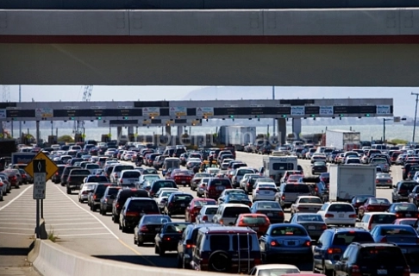
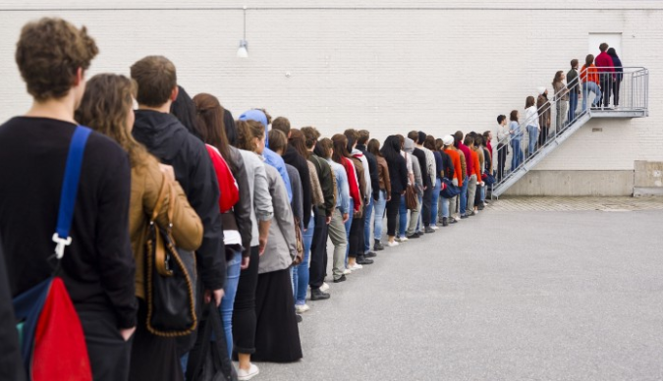
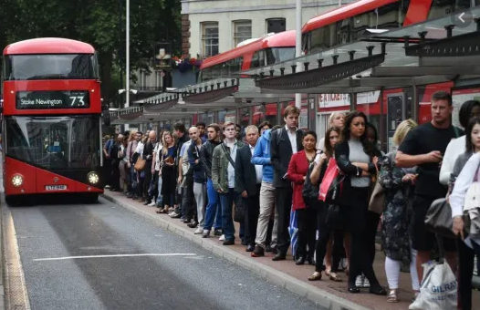
Packet-switching: queueing
R = 100 Mb/s
C
A
R = 1.5 Mb/s
D
B
E
queue of packets
waiting for transmission over output link
Queueing occurs when work arrives faster than it can be serviced:

Slide 8
Packet-switching: queueing
R = 100 Mb/s
C
A
R = 1.5 Mb/s
D
B
E
queue of packets
waiting for transmission over output link
Packet queuing and loss: if arrival rate (in bps) to link exceeds transmission rate (bps) of link for some period of time:
packets will queue, waiting to be transmitted on output link
packets can be dropped (lost) if memory (buffer) in router fills up

Slide 9

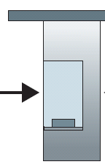
Caravan analogy
100 km
100 km
ten-car caravan
(aka 10-bit packet)
toll booth
toll booth
toll booth
(aka link)
toll booth
toll booth
(aka link)
car ~ bit; caravan ~ packet; toll service ~ link transmission
toll booth takes 12 sec to service car (bit transmission time)
“propagate” at 100 km/hr
Q: How long until caravan is lined up before 2nd toll booth?
time to “push” entire caravan through toll booth onto highway = 12*10 = 120 sec
time for last car to propagate from 1st to 2nd toll both: 100km/(100km/hr) = 1 hr
A: 62 minutes
Notes:
This problem clarifies the notion of transmission and propagation delay.
Think of the highway segments between tollbooths as links and tollbooths as routers.
The cars travel (that is propagate) on the highway as a rate of 100km / hour.
Each car follow in a fixed order (like a bit of a larger packet).
Each car is serviced by each toll booth at a rate of 12 secs.
And finally as the first car arrives at the toll booth, it must wait for the last car to arrive before
it can travel on to the next toll booth.
So, to calculate the transmission delay (the time it takes to put 10 cars onto the link) ==
12 sec * 10 cars = 120secs (2 minutes)
Or using the previous formulae: transmission delay (L-bits/R-bits per sec) ==
10 cars/(5 cars/minute)=10cars /(5 cars /60 sec) = 120 seconds.
This is analogous to the transmission delay in a router.
Next we look at Propagation Delay:
Lets look at the time it takes for one car to travel from the exit of one tollbooth to the next tollbooth:
Propagation is d/s == distance / speed == 100 km / (100 km /hour(60*60)) == 3,600 seconds = (60 minutes or 1 hour).
So the time it takes to move the 10 cars from the start of the first tollbooth to the second tollbooth is Transmission delay + Propagation delay == 120 seconds + 3,600 == 3,720 seconds == 62 minutes

Slide 10
Packet loss
queue (aka buffer) preceding link in buffer has finite capacity
packet arriving to full queue dropped (aka lost)
lost packet may be retransmitted by previous node, by source end system, or not at all
buffer
(waiting area)
A
packet being transmitted
B
packet arriving to
full buffer is lost

Slide 11
Throughput
throughput: rate (bits/time unit) at which bits are being sent from sender to receiver
instantaneous: rate at given point in time
average: rate over longer period of time
link capacity
R_{s} bits/sec
link capacity
R_{c} bits/sec
pipe that can carry
fluid at rate
(R_{s} bits/sec)
pipe that can carry
fluid at rate
(R_{c} bits/sec)
server sends bits
(fluid) into pipe
server, with
file of F bits
to send to client

Slide 12
Throughput
R_{s} < R_{c} What is average end-end throughput?
R_{s} bits/sec
R_{c} bits/sec
R_{s} > R_{c} What is average end-end throughput?
R_{s} bits/sec
R_{c} bits/sec
bottleneck link
link on end-end path that constrains end-end throughput

Slide 13
Throughput: network scenario
per-connection end-end throughput: min(R_{c},R_{s},R/10)
in practice: R_{c} or R_{s} is often bottleneck
R_{s}
R_{s}
R_{s}
R
R_{c}
R_{c}
R_{c}
10 connections (fairly) share backbone bottleneck link R bits/sec

Slide 14

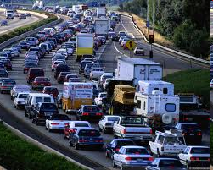
Packet queueing delay (revisited)
a: average packet arrival rate
L: packet length (bits)
R: link bandwidth (bit transmission rate)
average queueing delay
L
a
.
:
arrival rate of bits
“traffic
intensity”
R
service rate of bits
traffic intensity = La/R
1
La/R ~ 0: avg. queueing delay small
La/R -> 1: avg. queueing delay large
La/R > 1: more “work” arriving is more than can be serviced - average delay infinite!
La/R ~ 0
La/R -> 1

